Slide 1
Database Replication with Debezium
THACH LE / SOFTWARE ENGINEER

Slide 2
Contents
Use case
Introduction
Architecture
Deployment

Slide 3
Use case
Currently, we provide database access from external. These queries are reports basic, resulting in a significant load on our system.

Slide 4
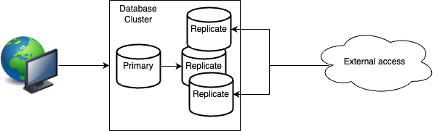
Use case
Notes:
Very first solution, we think about providing access through replicate instance of the cluster.
But first, it can may effect our primary database.
Second, we can exclude some tables from replicating with some data changes

Slide 5
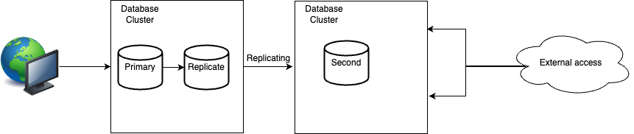
Use case
Notes:
That why we need to create a second database for external access. And Debezium is a service for real time replication.

Slide 6
Introduction
What is Kafka Connect?
Kafka Connect is a tool for streaming data between Apache Kafka and other data systems.
Notes:
What is Kafka Connector
https://www.confluent.io/product/connectors/

Slide 7
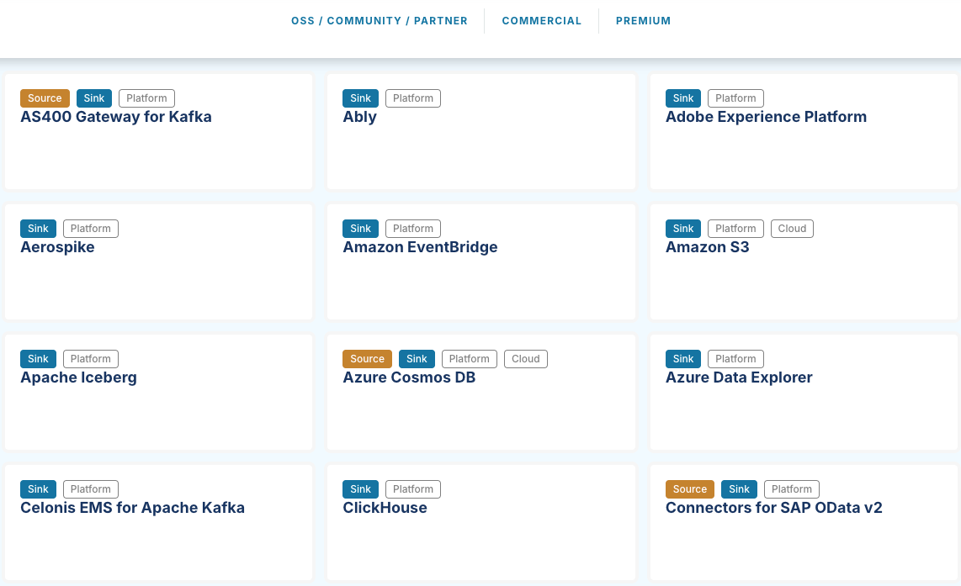
Introduction
Kafka Connectors
Notes:
What is Kafka Connector
https://www.confluent.io/product/connectors/

Slide 8
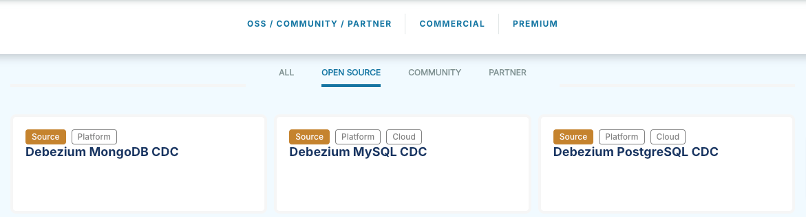
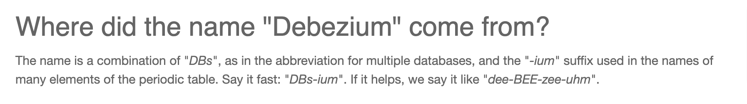
Introduction
What is Debezium?
Notes:
Debezium use the Kafka Connect framework.
Debezium is a set of distributed services to capture changes in databases

Slide 9
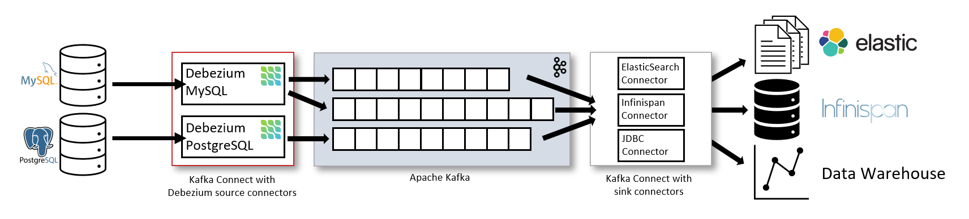
Architecture
Debezium Architecture
Notes:
MySQL has a binary log (binlog) that records all operations in the order in which they are committed to the database.
This includes changes to table schemas as well as changes to the data in tables. MySQL uses the binlog for replication and recovery.
Initial Snapshot: Before starting to read the binlog, the connector takes an initial consistent snapshot of the database. This ensures that it has a complete view of the data at a specific point in time.
After the snapshot, it continues to read from the binlog to capture ongoing changes.
The Debezium MySQL connector reads the binlog, produces change events for row-level INSERT, UPDATE, and DELETE operations, and emits the change events to Kafka topics. Client applications read those Kafka topics.

Slide 10
Deployment
MySQL Config
Properties | Value
log_bin | ON
binlog_format | ROW
binlog_row_image | FULL

Slide 11
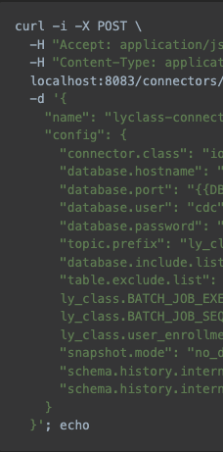
Deployment
MySQL Connector

Slide 12
Deployment
Deployment with minimal downtime
Currently, our database has tens of GB in size. Replicating from the beginning would require taking a snapshot and replicating the source data, which could result in hours of downtime.
Notes:
While creating snapshot, primary database was block write

Slide 13
Deployment
Deployment with minimal downtime
Step 1: Create MySQL Connector with snapshot.mode = no_data
Step 2: Dump data from data source (primary database)
Step 3: Import data to data target (second database)
Step 4: Start consumer and begin replicate to second database
Notes:
Downtime only happen on Step 1 and 2 (block write)
Step 1: ~1 minute
Step 2: ~2 minutes
From step 3, changes data to primary data was push to Kafka

Slide 14
Thank you

